Slide 1
Automated System and Acceptance Test
I4SWT

Slide 2
System and acceptance test
Requirements
Accept testing
System specification
System testing
System design
Integration testing
Component design
Unit test
Implement component

Slide 3
System test: Compare and contrast
System tests are like other tests in that they…
Require a test setup
Require expected and actual outputs, and evaluation
Are made easier by control of external dependencies
System tests differ from other tests in that they…
Run on the complete system – makes validation harder
Can test a lot of aspects that are less relevant for unit/integration tests
Run in the real environment, not a test bench

Slide 4
System test types
Usability
Functionality
Performance
Scalability
Reliability
Load/stability
Security
…

Slide 5
Automation of system test
Advantages
Repeatable
Objective
Exhaustive/comprehensive (code coverage)
They will be executed
You don't need a user/product owner

Slide 6
Automation of system test
Disadvantages
May be hard or expensive to construct
or have only partial similarity to real use
It's an excuse for NOT involving the user/PO
Endangering the user feedback in agile processes
Monkey tests (for robustness)
or Explorative tests (for Agile feedback)
are not a included

Slide 7
Verification/Validation
Verification – did we do it correctly?
Structured and disciplined deduction if we have done correctly everything we specified
e.g. automated tests
Validation – did we make the right thing?
Open minded and disciplined deduction if the specification was good enough
e.g. by letting the user use the system under test

Slide 8
Types of Automated System Test
Testing of the GUI and through the GUI
Executable Specifications

Slide 9
Automated UI tests - methods
Graphical/low level comparison
Suitable for look and feel tests
Exact X/Y coordinates, mouse and keyboard
Exact image comparison pixel by pixel
Intelligent image comparison – e.g. OCR
Using the Document Object Model
Suitable for multiplatform tests
Using UI element ID's to click and type
Using UI elements contents and state after action

Slide 10
Excecutable specifications
Requirements
Executable Specification
Acceptance Test
Requirements
Accept testing
System specification
System testing
System design
Integration testing
Component design
Unit test
Implement component

Slide 11
Gherkin Feature example
Feature: MicrowavePower
I want to cook or heat my food
at the correct power
@power1
Scenario: Set Power once
Given The oven is reset
When I press the power button 1 time(s)
Then then the display should show 50 W
Name
Description
Name
Arrange
Act
Assert

Slide 12
Executable specifications with Gherkin
Advantages
Can involve the user/PO closer to the product
More concise than pure text
Combines requirements and test specification
Supports user stories, Behavior Driven Development, Feature Driven Development, agile processes
Disadvantages
The general disadvantages mentioned above
You only get a code skeleton
Does the user trust this translation

Slide 13
Structure of Gherkin elements
Steps can be reused between Scenarios

Slide 14
Executable Specification Tool
SpecFlow is a Visual Studio Extension, can be installed under Tools/Extensions and Updates..
A Unit Test Project must be created
The following NuGet packages must be installed for this project:
SpecFlow.NUnit
SpecFlow.NUnit.Runners
NUnit3TestAdapter

Slide 15
Executable Specification Tool
Add Item SpecFlow Feature file
Edit a feature and scenario(s) as a Gherkin specification
Right click and select Generate Step Definitions
Save the proposed file
Remove the SpecFlowNUnitExtensions.cs

Slide 16
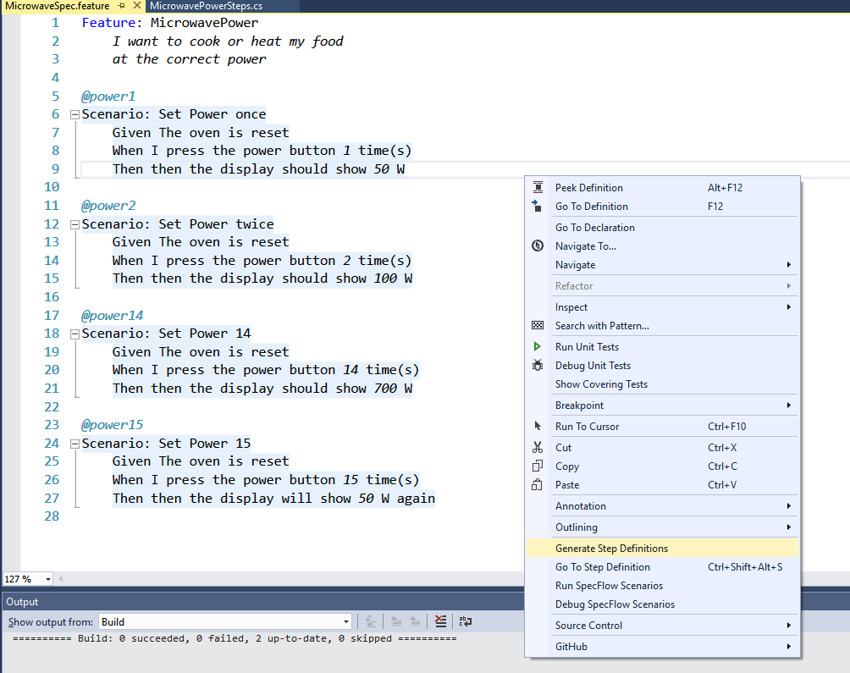
Generate Step Definition

Slide 17
Generated code skeletons/templates
namespace Microwave.Test.AcceptTest
{
[Binding]
public class MicrowavePowerSteps
{
[Given(@"The oven is reset")]
public void GivenTheOvenIsReset()
{
ScenarioContext.Current.Pending();
}
[When(@"I press the power button (.*) time\(s\)")]
public void WhenIPressThePowerButtonTimeS(int p0)
{
ScenarioContext.Current.Pending();
}
[Then(@"then the display should show (.*) W")]
public void ThenThenTheDisplayShouldShowW(int p0)
{
ScenarioContext.Current.Pending();
}
Arrange code can be inserted here
Steps can be reused, because a value is replaced by a regular expression
Act code must be inserted here
Assert code can be inserted here

Slide 18
Given step
public partial class MicrowaveSteps
{
private IOutput output;
private Timer timer;
private Display display;
private PowerTube powerTube;
private CookController cooker;
private UserInterface ui;
private Light light;
private Button powerButton;
private Button timeButton;
private Button startCancelButton;
private Door door;
[Given(@"The oven is reset")]
public void GivenTheOvenIsReset()
{
output = Substitute.For<IOutput>();
powerButton = new Button();
timeButton = new Button();
startCancelButton = new Button();
door = new Door();
timer = new Timer();
display = new Display(output);
powerTube = new PowerTube(output);
light = new Light(output);
cooker = new CookController(timer, display, powerTube);
ui = new UserInterface(
powerButton, timeButton, startCancelButton,
door,
display, light, cooker);
cooker.UI = ui;
}
Setup like in [SetUp]

Slide 19
When and Then step
[When(@"I press the power button (.*) time\(s\)")]
public void WhenIPressThePowerButtonTimeS(int p0)
{
for (int i = 0; i < p0; ++i)
powerButton.Press();
}
[Then(@"then the display should show (.*) W")]
public void ThenThenTheDisplayShouldShowW(int p0)
{
output.
Received(1).
OutputLine(Arg.Is<string>(str =>
str.Contains($"Display shows: {p0} W")));
}

Slide 20
Matching generated code
A step becomes a method in a class

Slide 21
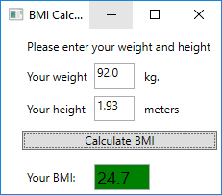
Combining Executable Specifications with GUI Testing
Create a scenario
Given weight is set to 92 kgs and height is set to 1.93 meters. When ”Calculate BMI” is pressed, Then the BMI should be 24.7
Use the GUI test framework to test from the generated code

